Slide 1


Introduction to Machine Learning
Welcome to this presentation on the fundamentals of machine learning. We'll cover the basics, explore key concepts, and discuss how machine learning is transforming our world. Get ready to learn about this exciting field!
by ram

Slide 2
What is Machine Learning?
Definition
Applications
Machine learning is a branch of artificial intelligence that allows computers to learn from data without explicit programming. It enables systems to adapt and improve their performance over time.
Machine learning powers diverse applications like spam filtering, fraud detection, recommendation systems, and self-driving cars. It's rapidly transforming industries across the globe.

Slide 3

Key Machine Learning Concepts
Data
Algorithms
Models
Machine learning thrives on data, and its quality and quantity directly impact model performance. Clean and diverse data are crucial for effective learning.
Machine learning algorithms are mathematical models that learn patterns from data. Different algorithms are suited to various tasks, like classification, regression, or clustering.
Models are the output of training an algorithm on data. They represent the learned patterns and can be used to make predictions on new, unseen data.

Slide 4



Supervised Learning
Labeled Data
Supervised learning uses labeled data, where each input example has a corresponding known output, allowing the algorithm to learn the relationship between them.
1
Model Training
2
The algorithm learns from the labeled data and creates a model that can predict the output for new, unlabeled inputs.
Prediction
3
Once trained, the model can predict the output for unseen data based on the patterns learned from the labeled examples.

Slide 5
Unsupervised Learning
Unlabeled Data
1
Unsupervised learning operates on unlabeled data, where the system discovers patterns and relationships without explicit guidance.
Clustering
2
One common unsupervised task is clustering, where the system groups similar data points together based on inherent characteristics.
Dimensionality Reduction
3
Another technique involves reducing the dimensionality of data while preserving important information, making it easier to analyze and understand.

Slide 6
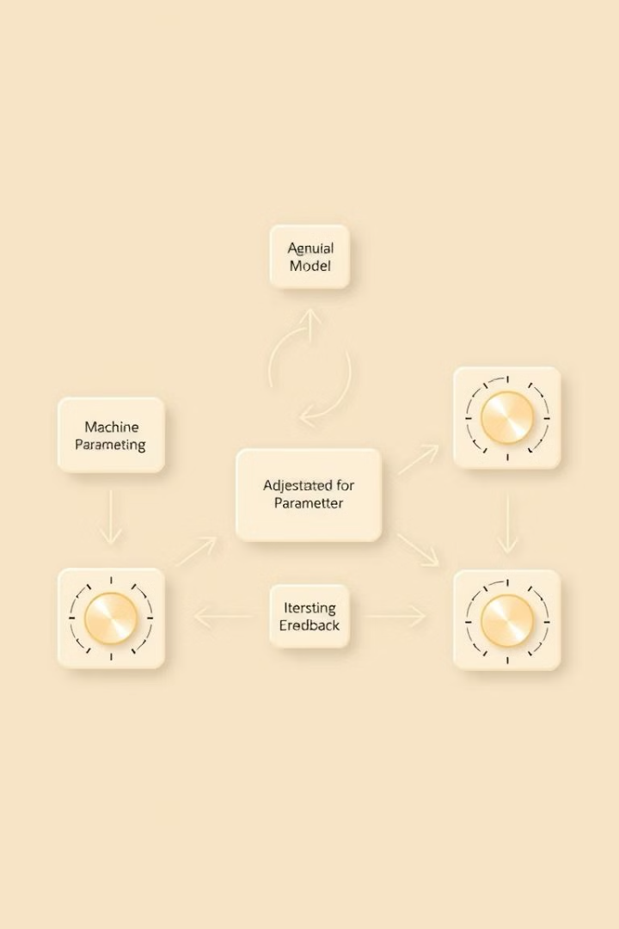



Model Training and Evaluation
Training
The model learns from the training data to find patterns and relationships, adjusting its parameters to minimize errors.
Validation
The model's performance is evaluated on a separate validation dataset to gauge its ability to generalize to unseen data.
Testing
Finally, the model is evaluated on a test dataset to assess its overall performance and ensure it meets the desired accuracy and reliability.

Slide 7

Real-World Machine Learning Applications
Healthcare
Finance
Machine learning is revolutionizing healthcare with applications like disease diagnosis, personalized treatment plans, and drug discovery.
Financial institutions utilize machine learning for fraud detection, risk assessment, and algorithmic trading, improving efficiency and accuracy.
E-commerce
Machine learning powers recommendation systems, personalized marketing, and automated customer service, enhancing customer experience and sales.

Slide 8

The Future of Machine Learning
1
Continued Growth
Machine learning is expected to continue its rapid development, impacting more aspects of our lives and shaping the future.
2
Ethical Considerations
Ethical considerations, such as bias and privacy, will play a critical role in shaping the responsible development and deployment of machine learning.
3
New Frontiers
We can expect new breakthroughs in areas like natural language processing, computer vision, and robotics, fueled by advancements in machine learning.

